Slide 1

Lexical flexibility: Expanding the empirical coverage
Daniel W. Hieber
University of California, Santa Barbara
danielhieber.com
Linguistics Colloquium, UC Santa Barbara, November 12, 2020

Slide 2

Lexical Flexibility
Bad Definition
The use of the same word for more than one part of speech (noun, verb, adjective).
When parts of speech are “fuzzy”, intersecting, or lacking entirely.
Notes:
parts of speech = lexical categories
I’ll give an improved definition in a bit.

Slide 3
English (Indo-European > Germanic)
N: And the spots of paint would change every hundred degrees.
V: One story does come to mind though where you painted the foundation coating on the house and got tar all over you.
A: And it happened to be one of the rare paint jobs.
Notes:
N V A = referring construction, predicate construction, modifying construction

Slide 4
English (Indo-European > Germanic)
Not flexibility:
N: administrator
V: administrate
A: administrative
unmarked (“primary” / “basic”) form
Notes:
Derivation implies directionality
One form is more “basic” (unmarked)
Question: Are flexible words like derived words? Is there directionality?

Slide 5
Mandinka (Mande > Manding)
N: Kuuráŋ‑o mâŋ díyaa.
sick-DEF PFV.NEG pleasant
‘Sickness is not pleasant.
V: Díndíŋ‑o máŋ kuraŋ.
child-DEF PFV.NEG sick
‘The child is not sick.’

Slide 6
Mundari (Austroasiatic > Munda)
buru=ko bai-ke-d-a.
mountain=3PL.SUBJ make-COMPL-TR-IND
‘They made the mountain.’
saan=ko buru-ke-d-a.
firewood=3PL.SUBJ mountain-COMPL-TR-IND
‘They heaped up the firewood.’
Notes:
Meaning is idiomatic
Why not “climb a mountain”? Or “overcome”? Or “be a mountain”?

Slide 7
Nuuchahnulth (Wakashan > Southern Wakashan)
N: watqšiƛ ʔaƛimt
watq‑ši(ƛ) ʔaƛa‑imt
swallow-MOM two-PAST
completely.swallowed two
‘He swallowed two of them […]’
V: wik̓aƛ haʔukšiƛ ʔaƛiičiƛ
wik‑ʼaƛ haʔuk‑ši(ƛ) ʔaƛa‑ʽi·čiƛ
not-FIN eat-MOM two-INCEP
didn’t ate became.two
‘He [Mink] didn’t eat them and [the crabs] became two.’
A: hiiɬtqyaap̓up ʔaƛa qʷayac̓iik
hiɬ‑tqya·p̓i‑up ʔaƛa qʷayac̓iːk
there-back-MOM.CAUS two wolf
put.on.the.back two wolf
‘Two wolves put [the dead wolf] on their back.’
Notes:
Meanings of different uses are not idiosyncratic
They’re entirely predictable for Nuuchahnulth

Slide 8
Quechua (Quechuan)
N: rikaškaː hatun‑(kuna)‑ta
I.saw big-(PL)-ACC
‘I saw the big one(s)’
V: chay runa hatun (kaykan)
that man big (is)
‘that man is big’
A: chay hatun runa
that big man
‘that big man’
Notes:
Meanings are predictable

Slide 9
Tongan (Austronesian > Polynesian)
N: na’e lele e kau fefiné
PAST run SPEC PL.HUM woman.DEF
‘The women were running.’
V: na’e fefine kotoa e kau lelé
PAST woman all SPEC PL.HUM run.DEF
‘The ones running were all female.’

Slide 10
Central Alaskan Yup’ik (Eskimo-Aleut > Yup’ik)
iqa- ‘dirt’; ‘be dirty’
-ngtak ‘very’
N: iqa-ngtak ‘one that is very dirty’
V: iqa-ngtaq- ‘be very dirty’
---
tangerr- ‘see’
-uaq ‘imitation, inauthentic’; ‘pretend to, without serious purpose’
N: tangerr-uaq ‘movie, vision, hallucination’
V: tangerr-uar- ‘hallucinate, watch a movie’
iqeq- ‘corner of mouth’
-mik ‘thing held in one’s mouth’; ‘to put in one’s mouth’
N: iq-mik ‘chewing tobacco’
V: iq-mig- ‘put in one’s mouth’
Notes:
Idiosyncratic meaning: movie vs. hallucination
Why not “watch a play”?
Idiosyncratic meaning: chewing tobacco
Why not “thermometer”?
The combination of form + function has to be conventionalized
Marianne gives examples of communities down the river from each other (Mohawk)

Slide 11

The “problem” of lexical flexibility
Notes:
[MOTIVATION: These are fun, but why do we care?]
Lexical flexibility is viewed as a PROBLEM [show slide title] for theories of parts of speech / lexical categories
Lexical categories focus on how we categorize words
How do we categorize the words in these examples?

Slide 12
Tongan (Austronesian > Polynesian)
N: na’e lele e kau fefiné
PAST run SPEC PL.HUM woman.DEF
‘The women were running.’
V: na’e fefine kotoa e kau lelé
PAST woman all SPEC PL.HUM run.DEF
‘The ones running were all female.’
Notes:
verb = past tense marker – ‘woman’ must be a verb
noun = definite marker – ‘woman’ must be a noun
This is also why that initial definition of lexical flexibility is bad.

Slide 13
The “problem” of lexical flexibility
Proposed Solutions
be selective about the criteria
methodological opportunism
treat them as separate words
overlooks a potentially huge portion of the lexicon
why are some words flexible (or not)?
create new supercategories
how do you explain the idiosyncratic / non-predictable meanings and gaps?
create new subcategories
why subcategories rather than categories?
where does the splitting stop?
deny the existence of categories
how to explain the prototypical patterns we see?
Notes:
Even if you analyze these words as distinct,
it’s an interesting question as to why flexibility
(or whatever you want to call it) happens at all
If we explain this way, we miss an interesting piece
about how language works.
separate words – lexical unity
heterosemy
supercategories
contentives / flexibles / monocategorial
verb / non-verb
verbs vs. verbo-nominals
meaning inferred from context
doesn’t work for idiosyncratic examples
items in a category should behave roughly the same
no categories
acategorial
precategorial
underspecified
vague
Not every language is like Nuuchahnulth
Not every word in every language is like Nuuchahnulth
Semantic definitions are wrong
Noun = person, place, thing, idea
But it’s a pretty good prototype – it works for most cases. Why?
You can’t completely deny that there’s something going on
that underlies the traditional categories of noun, verb, and adjective

Slide 14
A functional approach
Construction Grammar: Languages don’t have categories; they have constructions.
Notes:
Recent work in typology and cognitive linguistics suggests a way forward
Several key insights from different functionally-oriented fields come together
to give us a potential explanation for lexical flexibility

Slide 15
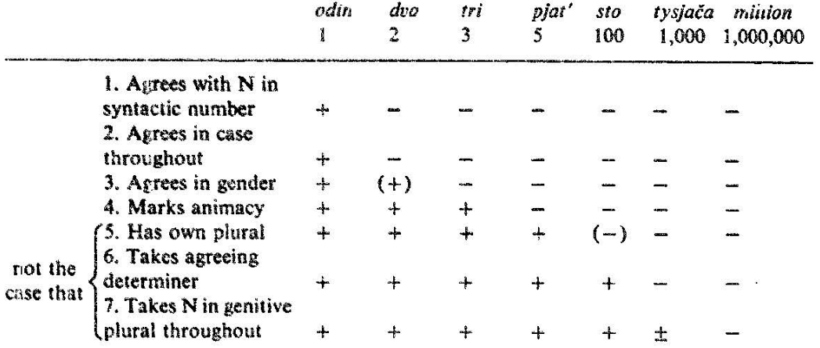
Numerals in Russian

Slide 16
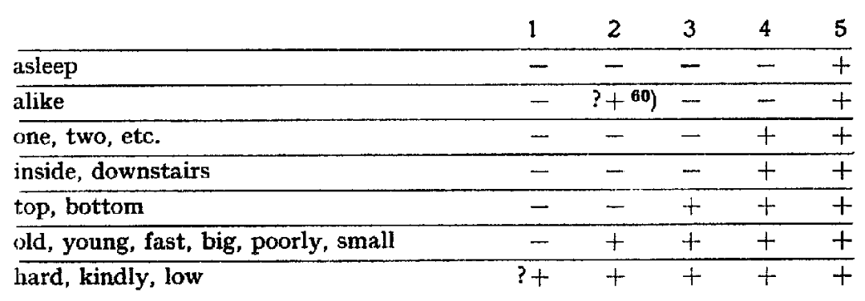
Adjectives & Adverbs in English

Slide 17
A functional approach
Construction Grammar: Languages don’t have categories; they have constructions.
Cognitive Linguistics: Mental categorization is prototypal.
Notes:
Constructions
solve the selectivity problem
solve the lumping / splitting problem

Slide 18
Prototypes in Categorization
Highly Prototypical
Less Prototypical
chair
sofa
couch
table
dresser
coffee table
desk
lamp
piano
mirror
television
stove
ashtray
telephone

Slide 19
Prototype Effects
prototypical members are consistently rated as good examples of the category
prototypical members are listed first
prototypical members are listed more frequently
prototypical members are identified more quickly

Slide 20
A functional approach
Construction Grammar: Languages don’t have categories; they have constructions.
Cognitive Linguistics: Mental categorization is prototypal.
The meanings and functions of words are also prototypal.
Typology: The uses of words in different functions are constrained by universals.
Notes:
Prototypes
solve the lexical unity (one word / multiple word) problem
explain the patterns we do see
N, V, and A are really just people imposing these mental prototypes on grammar.

Slide 21
Typological Markedness (Croft)
Parts of speech emerge from the way that speakers use object, action, and property words for different functions in discourse (reference, predication, and modification).

Slide 22
Typological Markedness (Croft)
Parts of speech emerge from the way that speakers use object, action, and property words for different functions in discourse (reference, predication, and modification).
MEANING | object
 | action
 | property

Slide 23
Typological Markedness (Croft)
Parts of speech emerge from the way that speakers use object, action, and property words for different functions in discourse (reference, predication, and modification).
 |  | FUNCTION
 |  | reference | predication | modification
MEANING | object
 | action
 | property
referent | = | noun
predicate | = | verb
modifier | = | adjective

Slide 24
Typological Markedness (Croft)
Parts of speech emerge from the way that speakers use object, action, and property words for different functions in discourse (reference, predication, and modification).
 |  | FUNCTION
 |  | reference | predication | modification
MEANING | object | prototypical noun
 | action |  | prototypical verb
 | property |  |  | prototypical adjective
referent | = | noun
predicate | = | verb
modifier | = | adjective

Slide 25
Typological Markedness (Croft)
 |  | FUNCTION
 |  | reference | predication | modification
MEANING | object | prototypical noun | predicate nominal | noun-noun modification
 | action | infinitive gerund action nominal | prototypical verb | participle relative clause
 | property | abstract noun | predicate adjective | prototypical adjective
referent | = | noun
predicate | = | verb
modifier | = | adjective

Slide 26
Typological Markedness (Croft)
 |  | FUNCTION
 |  | reference | predication | modification
MEANING | object | prototypical noun | predicate nominal | noun-noun modification
 | action | infinitive gerund action nominal | prototypical verb | participle relative clause
 | property | abstract noun | predicate adjective | prototypical adjective
These non-prototypical uses tend to have special markers for these functions!

Slide 27
Typological Markedness (Croft)
Non-prototypical uses of words are marked:
morphologically
behaviorally
frequentially
semantically

Slide 28
Typological Markedness (Croft)
Non-prototypical uses of words are marked at least as marked:
morphologically
behaviorally
frequentially
semantically
Stronger Claim: Non-prototypical uses of words are always marked in at least one of these ways, and perhaps always semantically.

Slide 29
Lexical Flexibility
Better Definition
The use of a lexical item (root, stem, or inflected word) in more than one discourse function (reference, predication, modification) with no overt derivational morphology.
Cheat Sheet
referent | = | noun
predicate | = | verb
modifier | = | adjective
Notes:
Now that we’ve seen some examples, here’s a better definition.
Since we’re questioning parts of speech like N, V, A, we can’t use them in our definition.
We define what we’re interested in in terms of the functions of words instead.

Slide 30

Lexical flexibility: A functional perspective
Lexical flexibility is the natural and expected result of the fact that these non-prototypical uses are not always morphologically marked, even when they are marked in other ways.
Lexical flexibility is not so much a problem as a design feature of language.
Notes:
Taking all these insights together, what can we say about lexical flexibility?
In other words: Lexical flexibility is exactly what you’d expect when non-prototypical uses of a word aren’t flagged in any special way.

Slide 31
Lexical flexibility: A functional perspective
A functionalist approach inverts the lexical flexibility question: The interesting question is not why some languages fail to make distinctions in parts of speech (framing it as a deficit), but rather why languages develop specialized constructions for different discourse functions in the first place.
Lexical flexibility exists in the areas where specialization has yet to develop in the grammar. It should be considered the natural state of affairs.
Notes:
Deficit approaches: Similar to pro-drop
Flexibility as the norm: Gil’s isolating-monocategorial-associationist language
It wasn’t until later that languages developed specialized machinery for distinguishing
different discourse functions in grammar.

Slide 32
Lexical flexibility as an object of study
Studies treating lexical flexibility as worthy of study in its own right, rather than a problem, are recent.
We know very little about the behavior or extent of lexical flexibility.

Slide 33
Behavior: Locus of Categoriality (root)
Central Alaskan Yup’ik (Eskimo-Aleut > Yup’ik)
iqa- ‘dirt’; ‘be dirty’
-ngtak ‘very’
N: iqa-ngtak ‘one that is very dirty’
V: iqa-ngtaq- ‘be very dirty’

Slide 34
Behavior: Locus of Categoriality (stem)
Coos (Coosan)
tsoːweˣtɬ
‘grease’
n̥-tsoːʷˣtɬ-ts
1SG-grease-TR
‘I greased it’
tɬʼkwiː
‘blanket’
tɬʼkwi-t
cover-TR
‘she covered [them] with blankets’

Slide 35
Behavior: Locus of Categoriality (inflected word)
Chitimacha (isolate)
Cayuga (Iroquoian)
dzampuyna
dza-m-puy-na
thrust-PLACT-HAB-NF.PL
V: ‘they usually thrust / spear (with it)’
N: ‘spear’
pamtuyna
pa-m-tuy-na
ford-PLACT-HAB-NF.PL
V: ‘they usually cross (it)’
N: ‘bridge’
o̜tekho̜nyáʔthaʔ
ye-ate-khw-o̜ni-aʔt-haʔ
INDEF.AGT-REFL-meal-make-INSTR-IPFV
V: ‘one makes a meal with it’
N: ‘restaurant’
kao̜tanéhkwi
ka-ro̜t-a-nehkwi
NEUT.AGT-log-EP-haul.IPFV
V: ‘it hauls logs’
N: ‘horse’
Notes:
Horse – idiosyncratic (why not “cart” or “tractor”?)
Iroquoian: N-V lexicalization cline

Slide 36
Extent of Flexibility: Mundari
reference only | 722 | 20%
predication only | 1,099 | 28%
reference and predication | 1,953 | 52%
Total | 3,824 | 100%

Slide 37
Extent of Flexibility: Central Alaskan Yup’ik
reference only | 35%
predication only | 53%
reference and predication | 12%
Total | 100%

Slide 38
Variability in Extent of Flexibility
 | Mundari | Yup’ik
reference only | 20% | 35%
predication only | 28% | 53%
reference and predication | 52% | 12%
Total | 100% | 100%
Notes:
There was a huge century-long debate about flexibility in Yup’ik, and only 12% of roots show flexibility!
Yup’ik – not sure about stems (might be more flexible); varies based on level of the grammar
Evans & Osada say 52% isn’t enough; the language isn’t flexible.
This ignores the behavior of 52% of the lexicon!
Yup’ik: We shouldn’t ignore the 12% just because it’s marginal.
That’s still a large percentage!
It’s precisely the marginal cases that are the hardest to explain from a functional perspective.
At the same time, that’s a disproportionate amount of attention in the literature!
Have linguists just paid attention to this where it’s caught their eye?

Slide 39
Open Questions on Lexical Flexibility
Generally how flexible are languages and individual words within them? Just how prevalent is lexical flexibility?
Is there a correlation between degree of flexibility for a word and its frequency / corpus dispersion?
What are the semantic properties of more or less flexible words?
Notes:
R2: “All words exhibit flexibility if you look at a big enough corpus.”
R3: Are there patterns to which words are more flexible than others?
I’ll make a very tiny foray into answering each of these today.

Slide 40
Data
English (Indo-European > Germanic)
Open American National Corpus
15 million words total
spoken portion: 3.2 million words (Charlotte + Switchboard)
Nuuchahnulth (Wakashan > Southern Wakashan; Vancouver Island)
Notes:
English: sometimes claimed to be rigid, other times flexible
Nuuchahnulth: one of the most-discussed languages,
famously claimed to lack a N-V distinction
flexibility is areal in the Pacific Northwest

Slide 41
(In)famous Nuuchahnulth Examples
qo·ʔas‑ma ʔi·ḥ‑ʔi
man-3SG.IND large-DEF
‘The large one is a man.
ʔi·ḥ‑ma ʔo·ʔas‑ʔi
large-3SG.IND man-DEF
‘The man is large.’
mamo·k‑ma ʔo·ʔas‑ʔi
work-3SG.IND man-DEF
‘The man is working.’
ʔo·ʔas‑ma mamo·k‑ʔi
man-3SG.IND work-DEF
‘The working one is a man.’
Notes:
It’s like a rite of passage to include these examples in a paper on lexical categories.
I was going to be hipster about it and swore I wouldn’t include them.
Flexibility is an areal trait in the Pacific Northwest.
They’re overdone and trite and don’t contribute anything to the discussion
because we don’t know how representative they are.
It turns out they’re incredibly relevant, so I had to include them after all.
You’ll understand why in a little bit.

Slide 42
Data
English (Indo-European > Germanic)
Open American National Corpus
15 million words total
spoken portion: 3.2 million words (Charlotte + Switchboard)
Nuuchahnulth (Wakashan > Southern Wakashan; Vancouver Island)
George Louie & Caroline Little, with Toshihide Nakayama (UCSB alum)
24 texts, 8,300 words (fully glossed)
All spoken texts: personal narratives, myths, procedural texts
Retyped texts in scription format; parsed into DaFoDiL format
Notes:
English: sometimes claimed to be rigid, other times flexible
Nuuchahnulth: one of the most-discussed languages,
famously claimed to lack a N-V distinction
flexibility is areal in the Pacific Northwest

Slide 43
Methods: Measuring Flexibility
Count the number of times that each lexeme (stem) is used for reference, predication, and modification.

Slide 44
English: paint
N: And the spots of paint would change every hundred degrees.
V: One story does come to mind though where you painted the foundation coating on the house and got tar all over you.
A: And it happened to be one of the rare paint jobs.

Slide 45
Methods: Measuring Flexibility
Count the number of times that each lexeme (stem) is used for reference, predication, and modification.
lexeme | reference | predication | modification | flexibility
paint | 131 | 139 | 47 | ???

Slide 46
Methods: Measuring Flexibility
Perfectly Flexible
Perfectly Rigid / Inflexible
lexeme | reference | predication | modification
stem | 100 | 100 | 100
lexeme | reference | predication | modification
stem | 300 | 0 | 0
uses are evenly distributed
functions are the most diverse

Slide 47
Methods: Measuring Flexibility
Count the number of times that each lexeme (stem) is used for reference, predication, and modification.
Calculate how diverse the functions of the lexeme are using a statistical diversity measure (normalized Shannon’s H).
lexeme | reference | predication | modification | flexibility
paint | 131 | 139 | 47 | ???

Slide 48
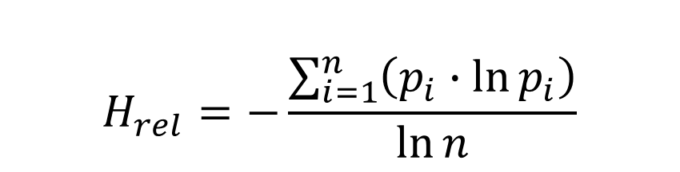
Methods: Measuring Flexibility
Shannon’s H
Shannon’s H Normalized (0 ≤ H ≤ 1)
Originally a measure of entropy (uncertainty / information content)
diversity = uncertainty
Frequently used as a diversity index in ecology.
$$H_{rel}=−\frac{\sum_{i=1}^{n}{\left(p_{i}∙\ln{p_{i}}\right)}}{\ln{n}}$$
# Shannon’s H for “paint”
frequencies <- c(131, 139, 47)
percents <- frequencies/sum(frequencies)
H <- sum(
percents * log(percents) /
log(length(percents))
)
# H ≈ 0.92

Slide 49
Methods: Measuring Flexibility
Count the number of times that each lexeme (stem) is used for reference, predication, and modification.
Calculate how diverse the functions of the lexeme are using a statistical diversity measure (normalized Shannon’s H).
lexeme | reference | predication | modification | flexibility
paint | 131 | 139 | 47 | 0.92
H ≈ 0.92
Very flexible!

Slide 50
Methods: Measuring Flexibility
Count the number of times that each lexeme (stem) is used for reference, predication, and modification.
Calculate how diverse the functions of the lexeme are using a statistical diversity measure (normalized Shannon’s H).
Repeat with other lexemes.
lexeme | reference | predication | modification | flexibility
paint | 131 | 139 | 47 | 0.92
study | 1 | 3 | 1 | 0.86
back | 272 | 54 | 143 | 0.84
end | 604 | 693 | 34 | 0.72
work | 1381 | 3698 | 323 | 0.71
⋮
know | 7 | 11496 | 41 | 0.03
hate | 0 | 442 | 2 | 0.03
week | 1476 | 0 | 3 | 0.01
way | 3730 | 1 | 1 | 0.005
like | 1 | 3105 | 0 | 0.003
Notes:
Did this for 100 lexemes of English (randomly chosen from different frequencies),
and all the lexemes of Nuuchahnulth.
Annotated 380,000 tokens of English.
Took about 3 months. (Thanks Tom & George!)
study: One of the least frequent words in the corpus.
know: This is the most frequent word in the corpus.
Does not include know as a discourse marker (you know)
About 30,000 instances total, only 1/3 of which are lexical
hate: We know that hate exists as a noun (They’ve got some real hate for that candidate.)
Even common constructions often don’t appear in big corpora.
A Google Books or Twitter search often confirms that such forms exist.

Slide 51
Methods: Measuring Flexibility
Repeat with other languages.
lexeme | gloss | reference | predication | modification | flexibility
hiš | all | 3 | 3 | 2 | 0.99
muː | four | 2 | 3 | 1 | 0.92
ʔaƛakʷaɬ | eight | 2 | 3 | 1 | 0.92
ʔuːš | some | 9 | 8 | 3 | 0.92
c̓awaːk | one | 3 | 8 | 2 | 0.84
⋮
ḥaw̓iɬ | chief | 29 | 6 | 0 | 0.42
wa· | say | 6 | 199 | 0 | 0.12
č̓apac | canoe | 36 | 1 | 0 | 0.11
quːʔas | person | 78 | 2 | 0 | 0.11
wik | not | 1 | 138 | 0 | 0.04
Notes:
Note: Overall frequencies are much lower (due to the small size of the corpus)
Note: Numerals, quantifiers, and property words are highly flexible
Explained by Thompson’s (1989) study of adjectives
say: One of the most frequent words in the corpus! (just like know in English)
man/person: One of the least flexible words in the corpus!
This word is the very example that Swadesh chose to illustrate flexibility!
He should have picked numbers!

Slide 52
(In)famous Nuuchahnulth Examples
qo·ʔas‑ma ʔi·ḥ‑ʔi
man-3SG.IND large-DEF
‘The large one is a man.
ʔi·ḥ‑ma ʔo·ʔas‑ʔi
large-3SG.IND man-DEF
‘The man is large.’
mamo·k‑ma ʔo·ʔas‑ʔi
work-3SG.IND man-DEF
‘The man is working.’
ʔo·ʔas‑ma mamo·k‑ʔi
man-3SG.IND work-DEF
‘The working one is a man.’

Slide 53
Methods: Measuring Flexibility
Repeat with other languages.
lexeme | gloss | reference | predication | modification | flexibility
hiš | all | 3 | 3 | 2 | 0.99
muː | four | 2 | 3 | 1 | 0.92
ʔaƛakʷaɬ | eight | 2 | 3 | 1 | 0.92
ʔuːš | some | 9 | 8 | 3 | 0.92
c̓awaːk | one | 3 | 8 | 2 | 0.84
⋮
ḥaw̓iɬ | chief | 29 | 6 | 0 | 0.42
wa· | say | 6 | 199 | 0 | 0.12
č̓apac | canoe | 36 | 1 | 0 | 0.11
quːʔas | person | 78 | 2 | 0 | 0.11
wik | not | 1 | 138 | 0 | 0.04
Notes:
man/person: One of the least flexible words in the corpus!
This word is the very example that Swadesh chose to illustrate flexibility!
Great examples of why we need better empirical coverage:
we’re making claims unbacked by data!

Slide 54
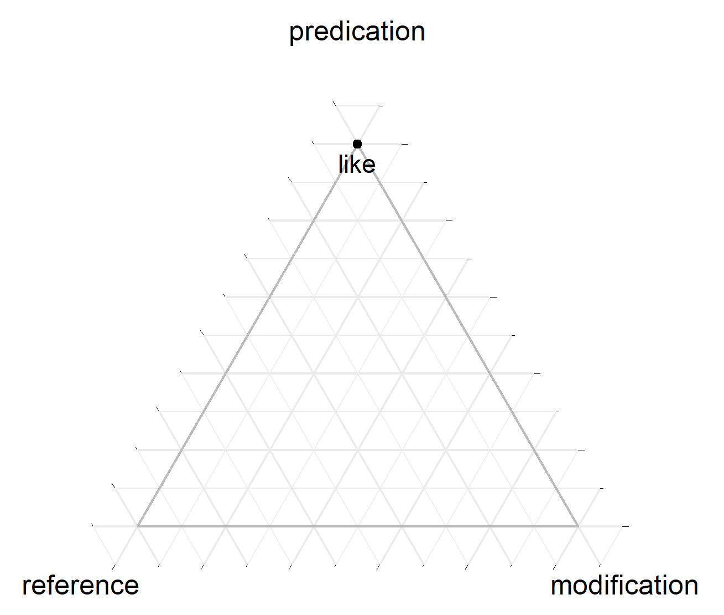
Methods: Measuring Flexibility
lexeme | reference | predication | modification | flexibility
like | 1 | 3105 | 0 | 0.003
Repeat with other languages.
Visualize the results.

Slide 55
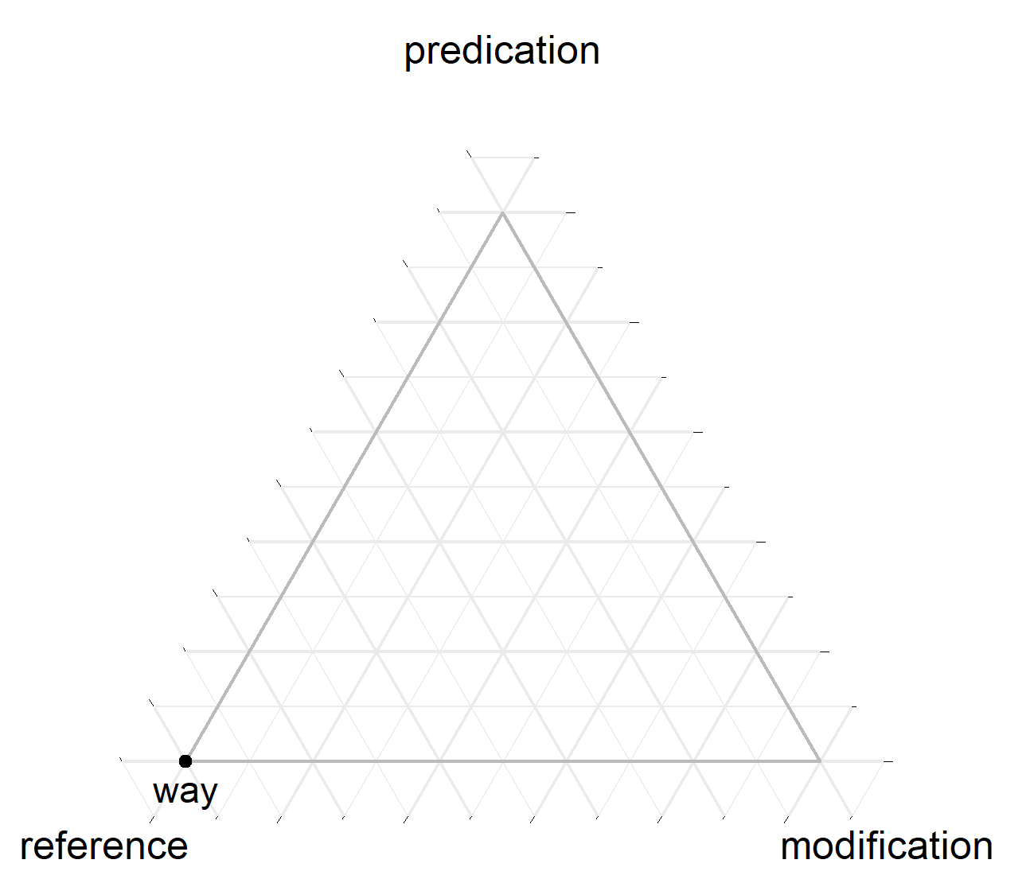
Methods: Measuring Flexibility
lexeme | reference | predication | modification | flexibility
way | 3730 | 1 | 1 | 0.005
Repeat with other languages.
Visualize the results.

Slide 56
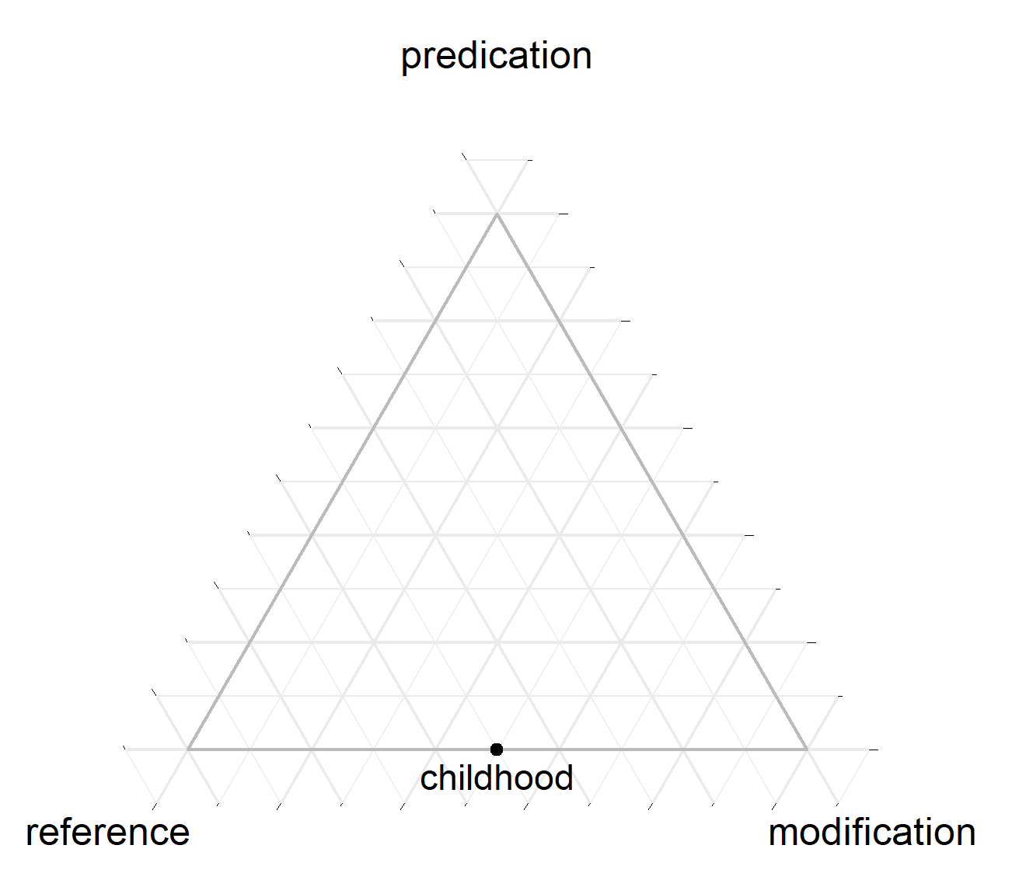
Methods: Measuring Flexibility
lexeme | reference | predication | modification | flexibility
childhood | 2 | 0 | 2 | 0.63
Repeat with other languages.
Visualize the results.

Slide 57
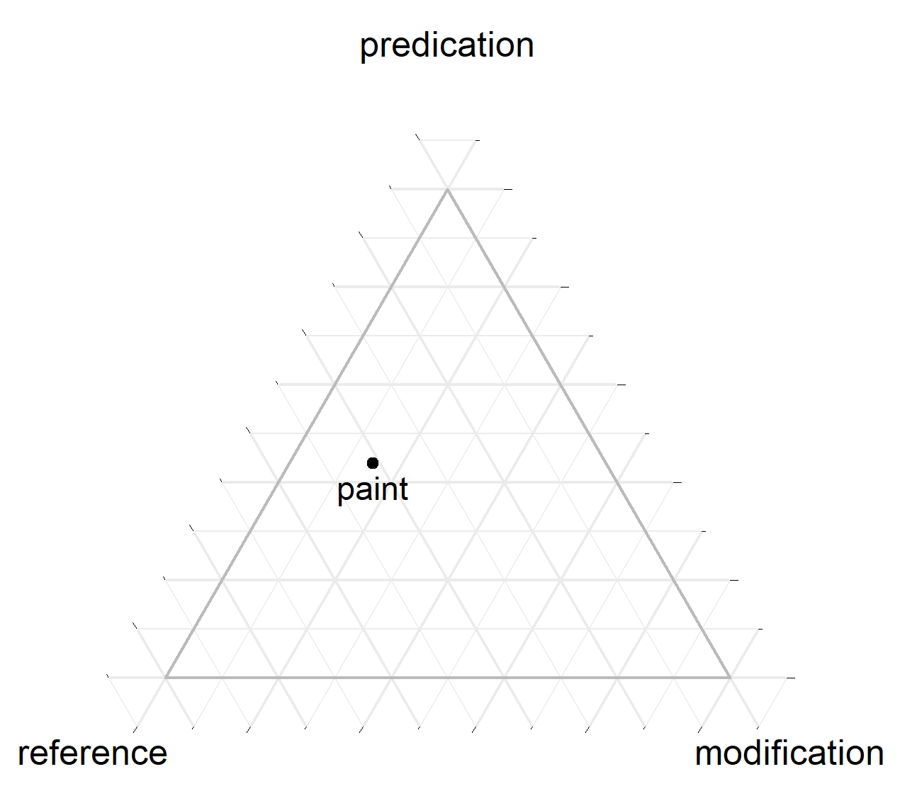
Methods: Measuring Flexibility
lexeme | reference | predication | modification | flexibility
paint | 131 | 139 | 47 | 0.92
Repeat with other languages.
Visualize the results.
Notes:
Visually speaking, flexible words sit right in the middle of the triangle.
Rigid words sit in the corners.
Moderately flexible words sit somewhere along the edges or slightly towards the middle.

Slide 58
Results
What happens when you plot an entire language?

Slide 59
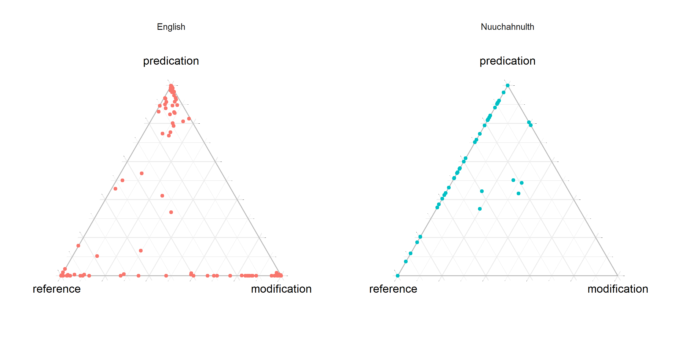
100-lexeme sample
Notes:
100-lexeme comparable sample
There are a lot of zero-flexibility words hiding in the corners.

Slide 60
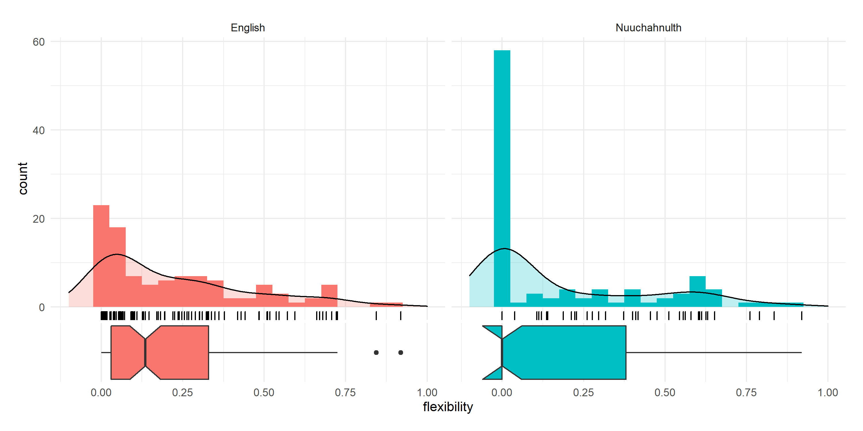
100-lexeme sample

Slide 61
100-lexeme sample
Notes:
Findings:
English clusters in the corners, with some shading into the center
English: All three functions are well represented
Nuuchahnulth doesn’t cluster in the corners at all
Nuuchahnulth: No modification
Nuuchahnulth: Full range of flexibility values along the reference-predication axis
These results fit most people’s intuitions about these languages:
English is mostly rigid, but most words exhibit a marginal degree of flexibility.
English words are primarily associated with one discourse function, but not exclusively so.
Nuuchahnulth shows a very high degree of noun-verb flexibility.

Slide 62
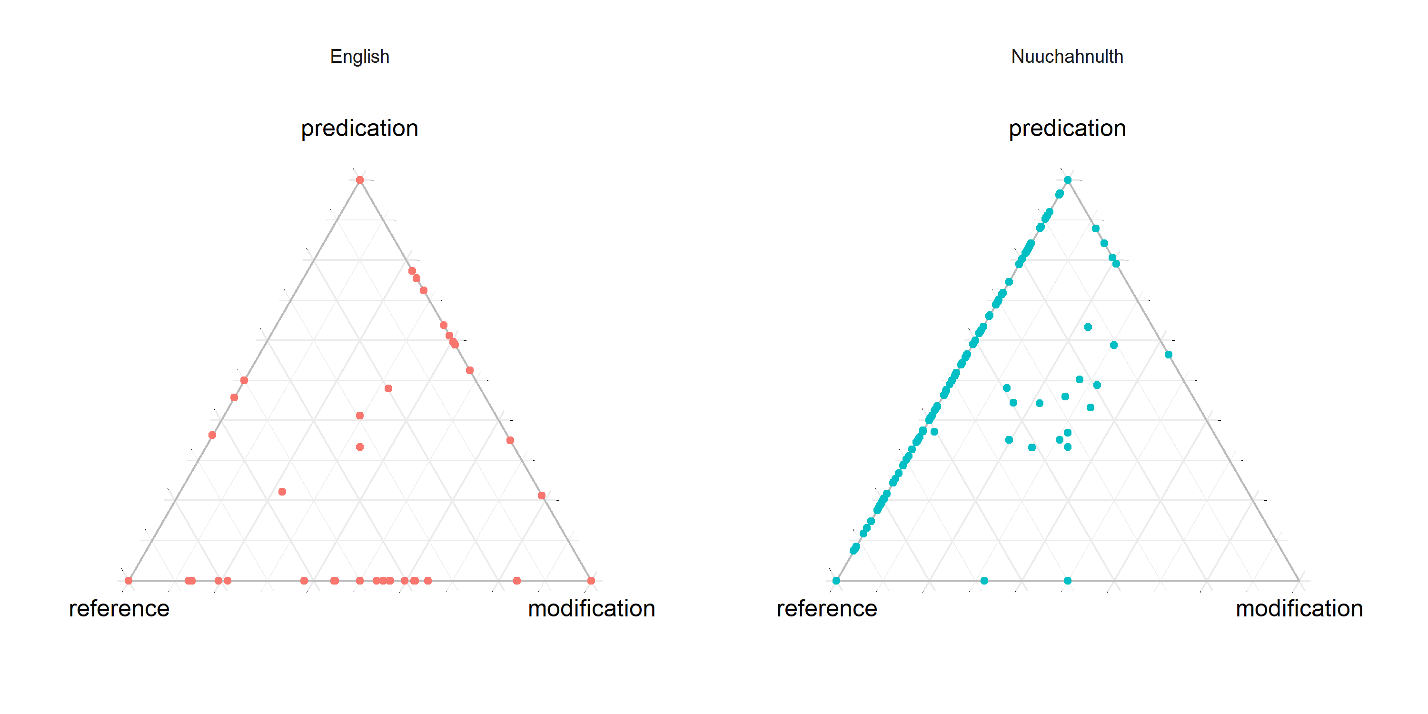
Small corpus sample (~10,000 tokens)
Notes:
Picture looks mostly the same for Nuuchahnulth
some more modifying uses appear
English looks very different – it’s unclear why!
Compared to the last set of plots, our Nuuchahnulth data got more robust, while the English data got less frequent.
The fact that Nuuchahnulth shows such extensive flexibility even within a really small corpus indicates just how flexible the language is!

Slide 63
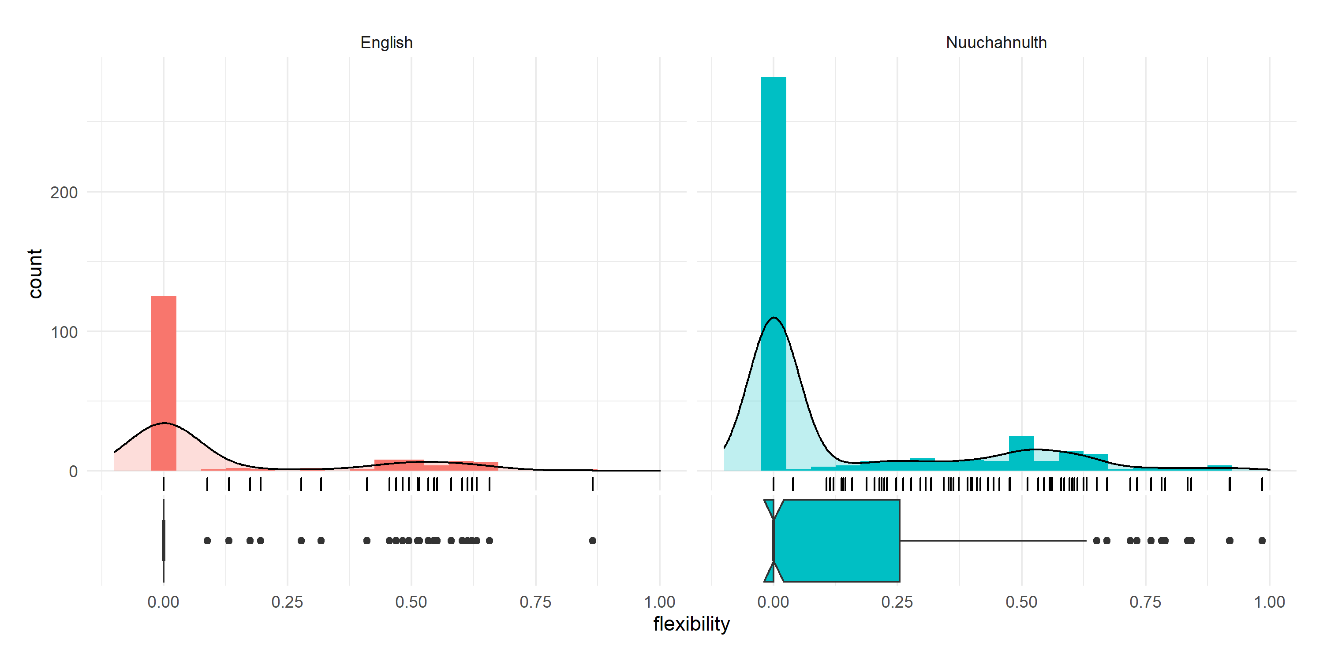
Small corpus sample (~10,000 tokens)
Notes:
The very skewed distributions here are probably a result of the small corpus sizes involved.
There does seem to be a relationship between corpus size and flexibility.
There does not seem to be a relationship between frequency and flexibility (at least based on my statistical work so far).

Slide 64
Semantic Patterns
Nuuchahnulth has a definite marker -ʔiː, which is always used to refer. It is sometimes thought to have a disambiguating function (e.g. when predicates are used to refer).
Nuuchahnulth has a set of aspect markers that indicate how speakers are construing the temporal structure of an event (e.g. something ongoing / continuous, bounded, repetitive, etc.)
Aspect markers in Nuuchahnulth are not always used to predicate. They can also be used on nominals. This is generally thought to be a contributing factor to Nuuchahnulth’s flexibility.
Notes:
Hypothesis: DEF used for non-prototypical referents

Slide 65
Semantic Patterns
Question: Are some aspect markers more strongly associated with certain discourse functions?
Question: Are some aspect markers more strongly associated with the definite marker?

Slide 66
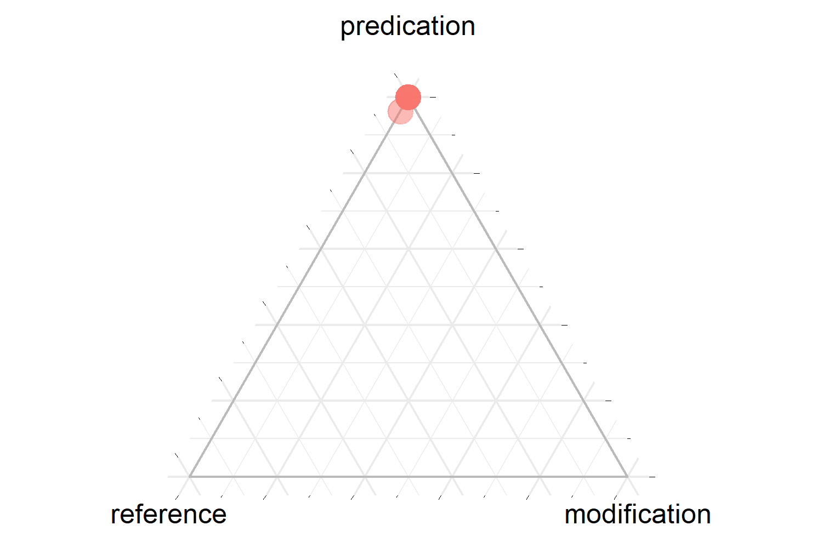
Continuative ‘ongoing’
Notes:
Aspect markers weren’t as common as I would have expected in general.
643 of the 1936 attested stems have aspectual markers.

Slide 67
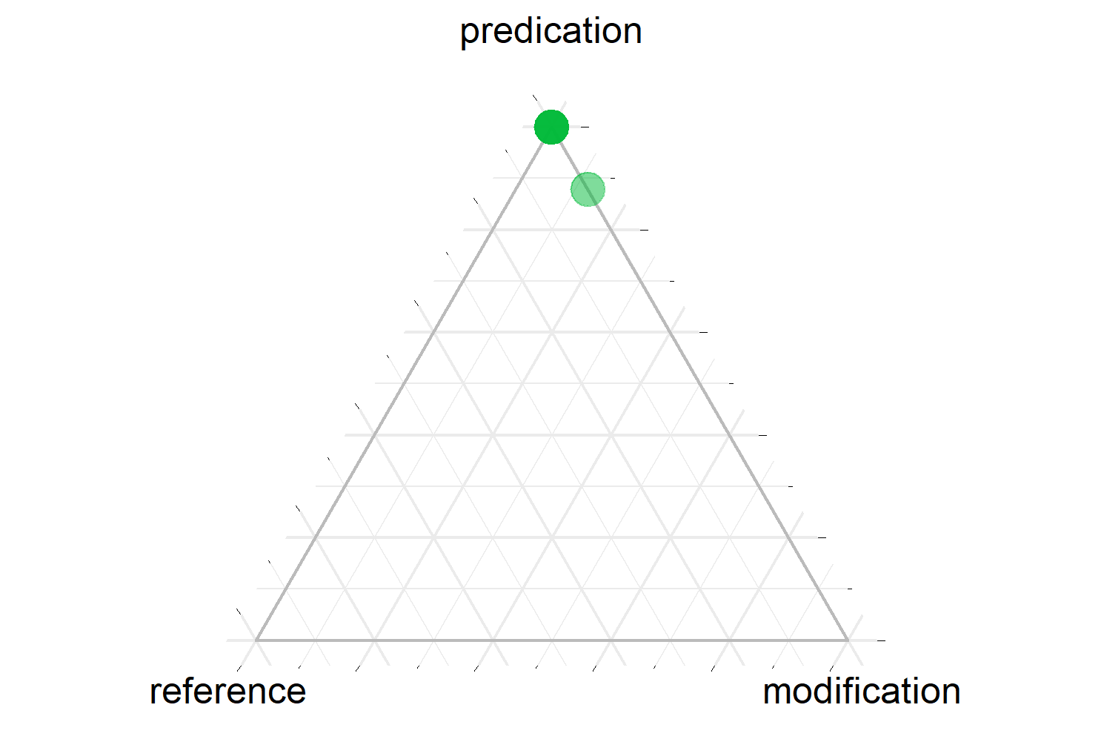
Inceptive ‘beginning’
Notes:
As expected.

Slide 68
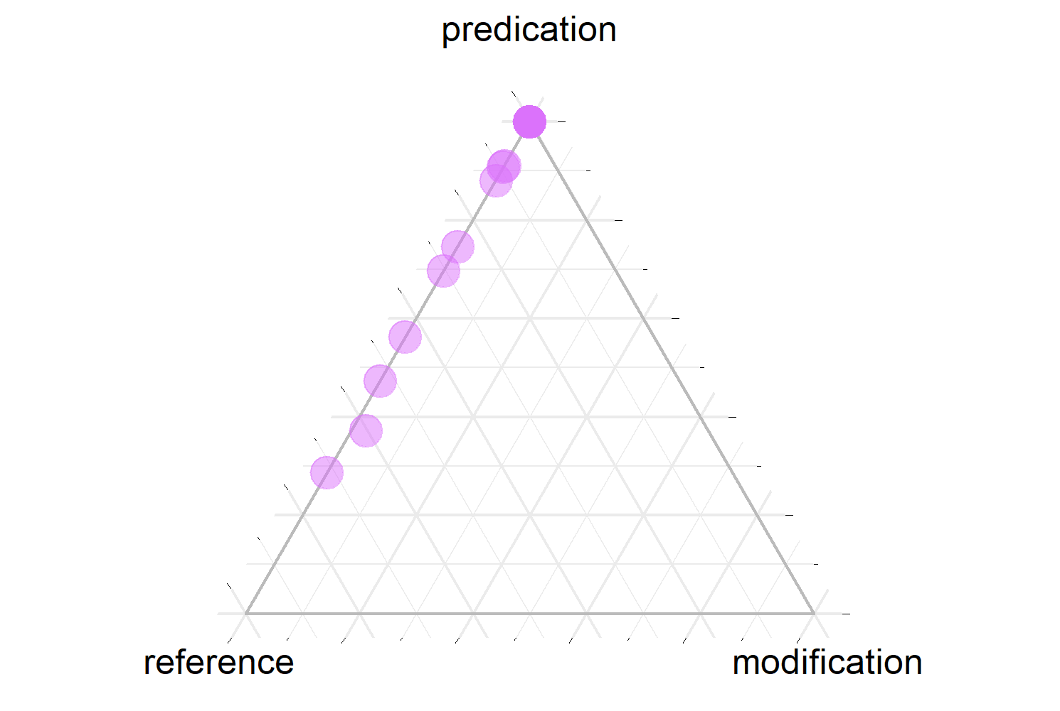
Telic / Finite ‘ended’
Notes:
As expected, some shading towards reference.

Slide 69
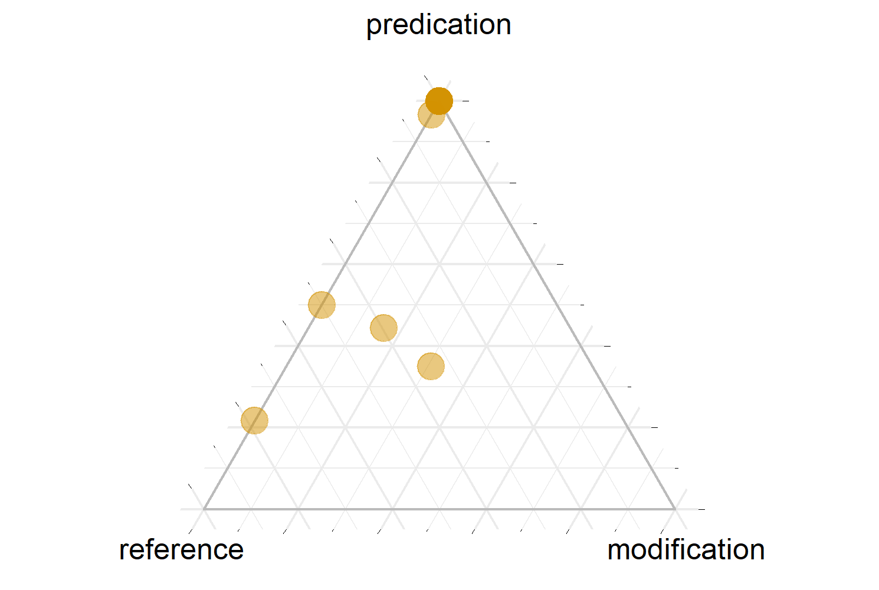
Durative ‘duration’
Notes:
The only aspect marker that shows any significant shading towards modification.

Slide 70
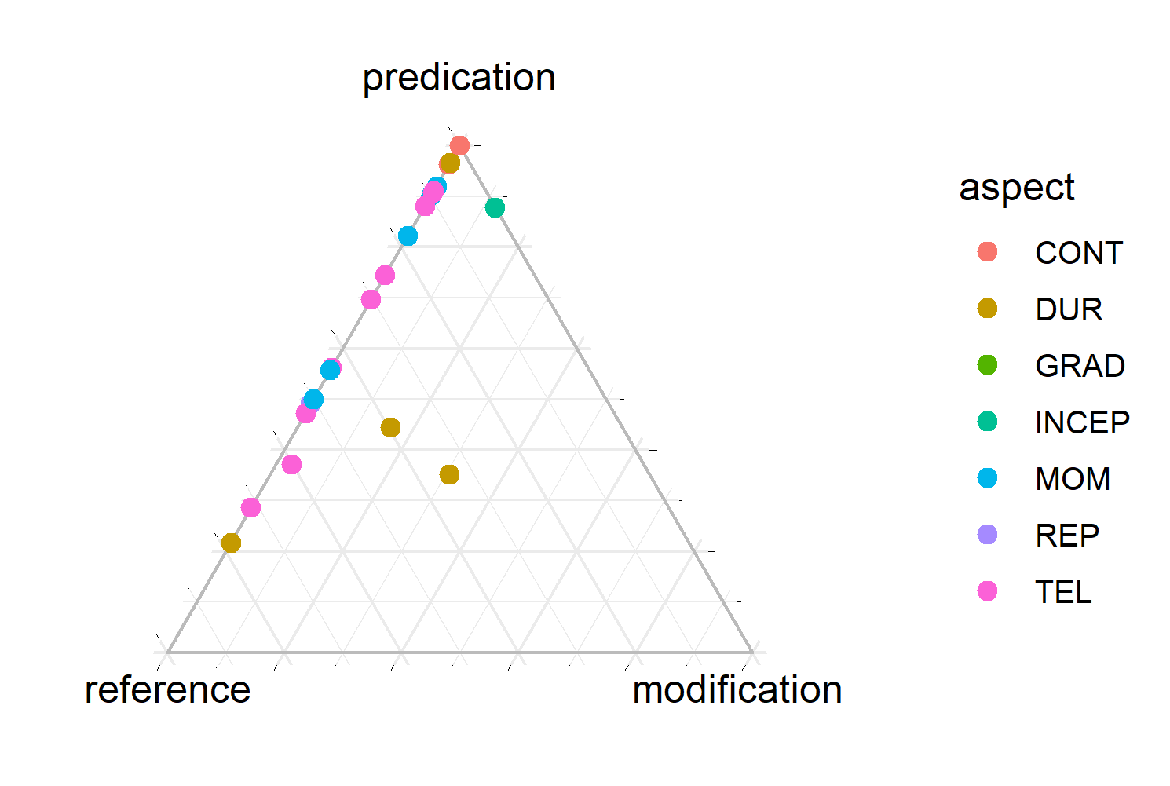
All Aspects
Notes:
Generally speaking, if a word has an aspect marker, it’s likely to be more strongly predicative than not.
The presence of any aspectual marker seems to correlate with an increased likelihood of being used for predication. This is a confirmation of Hopper & Thompson's (1984) hypothesis that lexical items used in their prototypical functions will show the inflectional behaviors typical of that function.

Slide 71
Nuuchahnulth Definite Markers vs. Aspect
Definite marker: 213 out of 1935 stems (11.01%)
Only 17 of these 213 (7.98%) have an aspect marker (CONT, DUR, MOM, TEL).
Definite markers and aspect markers are almost mutually exclusive. (Contrary to the great attention their overlap has received.)
Supports Hopper & Thompson’s (1984) claim that prototypical uses of words exhibit inflectional behavior characteristic of their class.
Even in a language with extensive flexibility, we still see evidence of prototypes. Flexibility is constrained by typological universals.
Notes:
There wasn't sufficient data to answer the RQ, but the reason why is telling.

Slide 72
Summary of Findings
Lexical flexibility differs significantly between languages.
English is consistently flexible, but only marginally.
Nuuchahnulth is highly flexible, but almost entirely along the noun-verb dimension.
The most flexible words in Nuuchahnulth are property words.
Prototypical uses of words in Nuuchahnulth bear inflectional marking characteristic of their meaning.

Slide 73
Contributions & Conclusions
Methodological: Measuring lexical flexibility
Empirical: Lexical flexibility is everywhere. Improved understanding of prevalence of lexical flexibility in English and Nuuchahnulth, and how it operates
Theoretical: Lexical flexibility is a natural result of the cognitive and diachronic forces at work in language
Notes:
I’ve been working on lexical flexibility for almost a decade now (2011, when I joined RS Research Labs).
I have yet to encounter a language that doesn’t exhibit flexibility in at least some area of its grammar, to some degree.
We can back our claims with data!
This work puts some empirical weight behind the idea that flexibility is the natural outcome of the interaction of cognition and grammar.

Slide 74


Thanks!

Slide 75
Bibliography
Broschart, Jürgen. 1997. Why Tongan does it differently: Categorial distinctions in a language without nouns and verbs. Linguistic Typology 1: 123–165. doi:10.1515/lity.1997.1.2.123.
Corbett, Greville G. 1978. Universals in the syntax of cardinal numerals. Lingua 46: 355–368. doi:10.1016/0024-3841(78)90054-2.
Creissels, Denis (2017): The flexibility of the noun/verb distinction in the lexicon of Mandinka. In Valentina Vapnarsky & Edy Veneziano (eds.), Lexical polycategoriality: Cross-linguistic, cross-theoretical and language acquisition approaches (Studies in Language Companion Series 182) John Benjamins. doi:10.1075/slcs.182.02cre.
Croft, William. 1991. Syntactic categories and grammatical relations: The cognitive organization of information. University of Chicago Press.
Croft, William. 2000. Parts of speech as typological universals and language particular categories. In Petra M. Vogel & Bernard Comrie (eds.), Approaches to the typology of word classes (Empirical Approaches to Language Typology 23), pp. 65–102. Mouton de Gruyter. doi:10.1515/9783110806120.65.
Croft, William. forthcoming. Word classes in Radical Construction Grammar. In Eva van Lier (ed.), The Oxford handbook of word classes. Oxford University Press.
Crystal, David. 1967. English. Lingua 17(3–4): 24–56. doi:10.1016/0024-3841(66)90003-9.
Evans, Nicholas, and Toshiki Osada. 2005. Mundari: The myth of a language without word classes. Linguistic Typology 9: 351–390. doi:10.1515/lity.2005.9.3.351.
Hieber, Daniel W. 2020. Scription. doi:10.5281/zenodo.2595548.
Hieber, Daniel W. 2020. The Data Format for Digital Linguistics (DaFoDiL). doi:10.5281/zenodo.1438589.
Hieber, Daniel W. 2023. Word classes. In Carmen Jany, Marianne Mithun & Keren Rice (eds.), The languages and linguistics of indigenous North America: A comprehensive guide (The World of Linguistics 13). Mouton de Gruyter.
Ide, Nancy & Keith Suderman. 2005. Open American National Corpus. http://www.anc.org/.
Little, Caroline. 2003. Caroline Little’s Nuu-chah-nulth (Ahousaht) texts with grammatical analysis (Endangered Languages of the Pacific Rim A2-27). Edited by Toshihide Nakayama. Nakanishi Press.
Louie, George. 2003. George Louie’s Nuu-chah-nulth (Ahousaht) texts with grammatical analysis (Endangered Languages of the Pacific Rim A2-028). Edited by Toshihide Nakayama. Nakanishi Press.
Mithun, Marianne. 2000. Noun and verb in Iroquoian: Multicategorisation from multiple criteria. In Petra M. Vogel & Bernard Comrie (eds.), Approaches to the typology of word classes (Empirical Approaches to Language Typology 23), pp. 397–420. Mouton de Gruyter. doi:10.1515/9783110806120.397.
Mithun, Marianne. 2017. Polycategoriality and zero derivation: Insights from Central Alaskan Yup’ik Eskimo. In Valentina Vapnarsky & Edy Veneziano (eds.), Lexical polycategoriality: Cross-linguistic, cross-theoretical and language acquisition approaches (Studies in Language Companion Series 182), pp. 155–176. Studies in Language Companion Series. Amsterdam: John Benjamins. doi:10.1075/slcs.182.06mit.
Rosch, Eleanor. 1975. Cognitive representations of semantic categories. Journal of Experimental Psychology: General 104(3): 192–233. doi:10.1037/0096-3445.104.3.192.
Frachtenberg, Leo J. 1922. Coos. In Franz Boas (ed.), Handbook of American Indian languages, Part 2 (Bureau of American Ethnology Bulletins 40), pp. 297–430. Smithsonian Institution.
Schachter, Paul, and Timothy Shopen. 2007. Parts-of-speech systems. In Timothy Shopen (ed.), Language typology and syntactic description, Vol. I: Clause structure (2e), pp. 1–60. Cambridge University Press. doi:10.1017/CBO9780511619427.001.
Swadesh, Morris. 1939. Nootka internal syntax. International Journal of American Linguistics 9(2): 77–102. doi:10.1086/463820.
Taylor, John R. 2003. Linguistic categorization (3e) (Oxford Textbooks in Linguistics). Oxford University Press.

